Slide 1
Welcome to Classes
Subj: Ideology & Constitutions of Pakistan
Notes:
Can Recall Previous Class?

Slide 2
BACKGROUND: First Constitution of Pakistan
Indian Independence Act 1947
Indian Act 1935
Bifunctional Constituent Assembly
First Constituent Assembly Setup
Notes:
Motivation
Can you recall Indian Act 1935, & Independence Act 1947
Act 1935: G.G can amend till March 31, 1948
After March 31, 1948 only CA can amend

Slide 3
India Act 1935
Fully enforced on 1 April 1937
Provided Federation: Provinces & States
Provincial Autonomy Given
Subjects: Federal, Provincial, Concurrent
NWFP was given full provincial autonomy
The council for the Secretary of State for India abolished/replaced with body of advisers 3-6 to Secretary of State
Federal Legislature; indirect election by the provincial assemblies
For the council of state direct election was proposed
Separate/communal electorate continued
G.G could suspend constitution=Martial Law
Dyarchy introduced at center
Defense, Finance, & Foreign Affairs kept under G.G with the advice of 3 advisers, appointed by him
Notes:
32 sections, 10 schedules, two parts

Slide 4
India Independence Act 1947
Royal Assent
18 July 1947
Both given full powers to makes laws
Britain was to have no control over the affairs after 15 August, 1947
Until constitution is not framed, India Act 1935 would be interim constitution; adopted with modification
Till 31 March 1948, G.G could amend, after it, C.A would amend 1935 Act.
G.G in the name of his Majesty will assent laws
The office of Secretary of State for India was to abolished
The Title of Emperor of India was replaced with King of England
Both could leave British Commonwealth of Nations if they so pleased

Slide 5
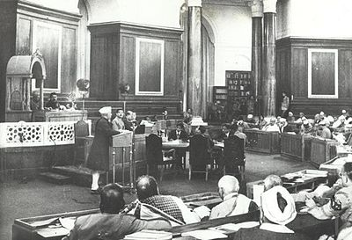
Constituent Assembly
Setup on 26 July, 1946 after Dec 1945 Elections
Region | No. Seats
East Bengal | 44
Punjab | 22
Sindh | 05
KPK | 03
Balochistan | 01
Khairpur | 01
State of Bahawalpur | 01
State of Balochistan | 01
States of KPK | 01
Total | 79

Slide 6









Comparison of:1956,1962,1973

Slide 7
Constitution

Constitution means a set of basic laws, rules, regulations which are necessary for running the administration of a state with an objective that people may lead an independent, discipline, peaceful and happy life.
Notes:
Family Units – big tribes – kingdoms – states.
Collection of rules, laws determine the powers and authority of the government
Relationship between Government and its Institutions
Rights of citizen
Require constitution so that no can cross the limits set in the constitution.

Slide 8
Importance of Constitution for a Nation
To Set limits among organs of states; executive, legislative & Judiciary
To provide fundamental rights; justice, equality & rights to individuals
To preserve democracy
To resolve conflicts among organs
To provide framework for legislation & amendments

Slide 9

Sources: Constitutions of Pakistan
Holy Quran
Sunnah
Objectives Resolution

Slide 10
Challenges before Constituent Assembly
Character of Constitution (Western or Islamic)
Distribution (Geographic & Representation)
Language Controversy (Urdu or Bengali)
Form of Govt. (Presidential or Parliamentary)

Slide 11
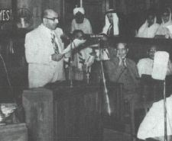
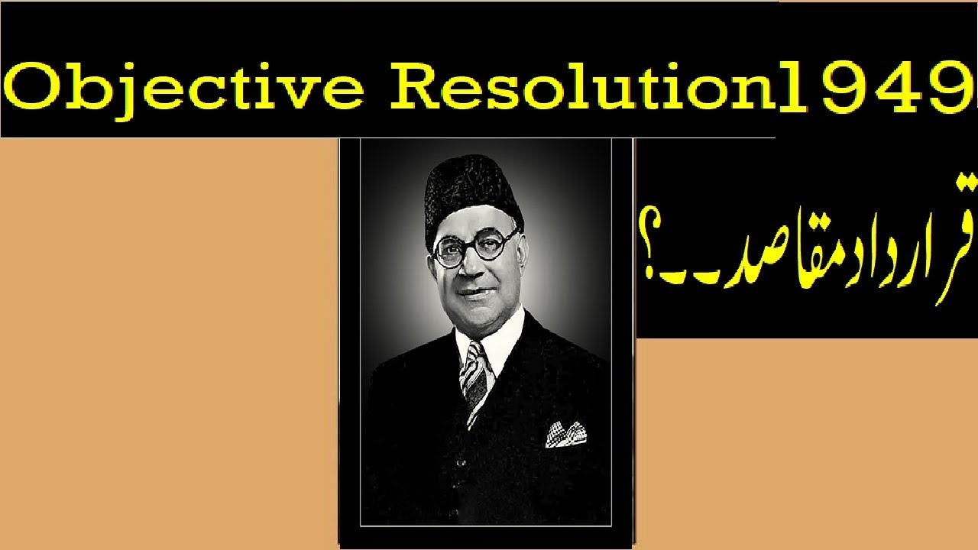
Sovereignty
Islamic Democracy [Secularism]
Minorities Protection
Federal Form
Fundamental Rights

Slide 12
Basic Principles Committee Report First: 28 Sept, 1950 Second: 22 Dec, 1952
Recommendations [2nd C.A]
HU: 120 & HP: 400
Conflict b/w house: joint sitting-solution ©
Federal & Provincial Govts for 5 years ©
Provincial Head by Head of State ©
Subjects: Federal, Provincial & Concurrent ©
Federal law was to prevail ©
A board of Ulema
Critiques:
East majority ignored
No provision in case no solution in the joint sitting
Remained silent on language
1. Federal & Provincial
2. Franchise 3. Judiciary
Board of Talimat-e-Islamia
Bogra Formula 7 Oct, 1953
Following Evetns: Dissolution of C.A, Maulvi Tamizuddin Case, Election to C.A
© Common

Slide 13
An important task done by Constituent Assembly was adoption of Objectives Resolution; the purpose of this resolution was to provide an outline and bases for the future constitutions. This resolution was presented by the first prime minister of Pakistan Liaquat Ali Khan on March 7, but adopted on March 12, 1949. Its important point are given below.
Sovereignty belongs to Almighty Allah. Allah alone possess authority to rule over the entire university. He dedicates his authority to the chosen representatives [by the public].
Objective resolution adopted Islamic Democracy against western democracy; this means that executives (prime minister and presidents) shall be Muslims only.

Slide 14
Constitutions Making
1956 | 1962 | 1973
P.M: Chaudri Rehmat Ali | Ayub Khan | Z.A Bhutto
Second C.A | Justice M. Shahabuddin: 17 Feb, 1960 (10-E, 10-W) | M.A Kasuri 17 April, 1972 (25 members)
C.A adopted on 29 Feb, 1956 | Quesionnaire 40 items, 9000 English, 19000 Urdu & Bengali | N.A thourgh Bill Passed 10 April, 1973
Enforcement: 23 March, 1956 | Enforcement: 8 June 1962 | Enforcement: 14 August, 1973

Slide 15
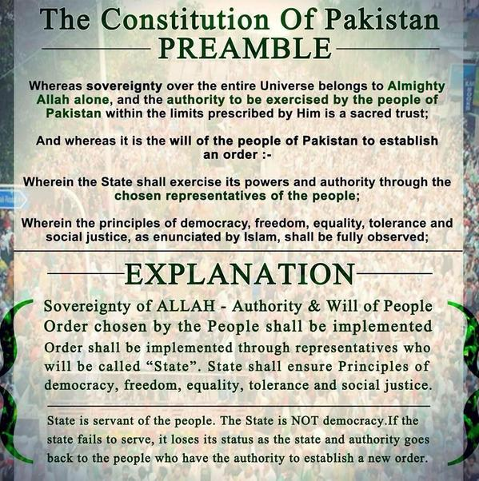
Notes:
A preamble is the introductory statement to a document, The Preamble explains the reasons behind the creation of the Constitution and its overall objectives.

Slide 16


Slide 17


Slide 18
Challenges before Constituent Assembly
Character of Constitution (Western or Islamic)
Distribution (Geographic & Representation)
Language Controversy (Urdu or Bengali)
Form of Govt. (Presidential or Parliamentary)
Sovereignty to Allah, Democracy, minorities,
Example.
Board of Talimat-e-Islamia
Council of Islamic Ideology, age 18+
Lets Compare Objectives Resolution with the Challenges
Accession of states, elected representatives
Urdu, its 1st BPC
Parliamentary
Notes:
1st BPC report Sept 28, 1950
Balochistan: Three smaller states—Kharan, Lasbela, and Makran—joined Pakistan in 1947.
The Khan of Kalat, Mir Ahmad Yar Khan, declared independence on August 12, 1947, after the end of British rule. Khan of Kalat agreed to the accession of Balochistan to Pakistan on March 27, 1948.
The area was officially designated as the province of Balochistan by the government of Pakistan on July 1, 1971.
Bahawalpur: The ruler of Bahawalpur acceded to Pakistan in October 1947, making it one of the first and smoother integrations, according to Quora.
Khairpur: Acceded to Pakistan in October 1947, reports World Statesmen.org.
Kalat: After resisting for a period, the Khan of Kalat finally acceded to Pakistan in March 1948, notes Quora.
Dir and Swat: These states acceded in 1947 but remained partially autonomous until fully integrated in 1969.

Slide 19
Khawaja dismissed April 16, 1953
Bogra Formula
CL
(UH-10 E & 40 W, LH- )
PM & President vice versa
President could dissolve CL
Bilingual
Bogra Formula 7 Oct, 1953
Notes:
PM April 17, 1953
Formula Oct 7, 1953 in NA
LH, 165-E, 135-W
Drafting Committee pointed under A.R Nishtar to draft constitution by 1st Jan 1955

Slide 20
Challenges before Constituent Assembly
Character of Constitution (Western or Islamic)
Distribution (Geographic & Representation)
Language Controversy (Urdu or Bengali)
Form of Govt. (Presidential or Parliamentary)
Sovereignty to Allah, Democracy, minorities,
Lets Compare Bogra Formula
with the Challenges
One Unit, Parity Formula
Urdu + Bengali
Parliamentary

Slide 21
2nd Constituent Assembly
1st CA Dissolved
Tamizuddin Case
Elections
Constitution 1956
First Constitution of Pakistan came into effect on March 23, 1956
Notes:
PRODA, Articles 9, 10, 10A, 10 B dissolved by C.A Sept 20, 1954
council of minister (8) under Bogra on Oct 26, 1954
Maulvi filed Nov 7, 1954
Federal Court gave decision August 11, 1955
Second CA: The second Constituent Assembly of Pakistan was created on 28th May (G.G’s Order No. 12)1955
Elections: ML-26, United Front-16, Awami L-13 + other = 80 seat of 2nd CA

Slide 22
Challenges before Constituent Assembly
Character of Constitution (Western or Islamic)
Distribution (Geographic & Representation)
Language Controversy (Urdu or Bengali)
Form of Govt. (Presidential or Parliamentary)
Sovereignty to Allah, Democracy, minorities,
Lets Compare First Constitution with the Challenges
West Pakistan Act,
NA (300)
Urdu, Bengali
Parliamentary
Notes:
West Pak Act Sept 30, 1955

Slide 23
BACKGROUND: Second Constitution of Pakistan
Martial Law
Dissolved Iskandar Mirza
Shahab Uddin Commission
Second Constitution of Pakistan came into effect on June 8, 1962
Notes:
Ayub ousted Mirza Oct 27, 1958 Nahid: "We cannot afford medical treatment, so just let me die.
PPO 1960 issued by Ayub
Commission (1+ 5-E, 5-W) Feb 17, 1960
Q-40 items, 9000 Eng, 19,000 Urdu, Bengali: 6, 269 replies
Constitution commission under Manzoor Qadeer Ext Minister Oct 31, 1961

Slide 24
Challenges before Constituent Assembly
Character of Constitution (Western or Islamic)
Distribution (Geographic & Representation)
Language Controversy (Urdu or Bengali)
Form of Govt. (Presidential or Parliamentary)
Sovereignty to Allah, Democracy, minorities,
Lets Compare Second Constitution with the Challenges
West Pakistan Act,
NA (157)
Urdu, Bengali
Presidential Form
Notes:
1st BPC report Sept 28, 1950

Slide 25
http://www.pakistani.org/pakistan/constitution/index.html
BACKGROUND: Third Constitution of Pakistan
Ayub to Martial Law
1. Elections
2. Separation of East-Pak
M. A Kasuri Commission
Third Constitution of Pakistan came into effect on August 14, 1973
Notes:
LFO March 30, 1970
Election shifted to Oct 1970 to Dec 7, 1970
Bengal Separation Dec 16, 1971
4. Causes of Separation of East Pak
a. Location, b. Martial Law, c. Language, d. Shaikh Mujeeb, e. War

Slide 26
Challenges before Constituent Assembly
Character of Constitution (Western or Islamic)
Distribution (Geographic & Representation)
Language Controversy (Urdu or Bengali)
Form of Govt. (Presidential or Parliamentary)
Sovereignty to Allah, Democracy, minorities,
Lets Compare Third Constitution with the Challenges
West Pakistan Act-X,
East Pak-X
NA (210), Senate (63)
Urdu
Parliamentary
17 - 25

Slide 27

Comparative Analysis

1956 Constitution | 1962 Constitution | 1973Constitution
Constitution-making : Enforced on 23 March 1956 to October 7, 1958. 234 Articles, 13 Parts and 6 Schedules Written Constitution | Enforced on June 8, 1962 to March 25, 1969. 250 articles, 12 Parts and 5 schedules. Written Constitution | Enforced on August 14, 1973 till now. 280 articles 12 Parts 7 Schedules Written Constitution
18
24
http://www.pakistani.org/pakistan/constitution/
Notes:
Parts to Chapter to Articles
Parts categorize the constitution with specific chapters (chapters has a group of articles together form a single part)
Schedule is Appendix: a detailed explaination of any article not mentioned in chapters/articles

Slide 28

Comparative Analysis

1956 Constitution | 1962 Constitution | 1973 Constitution
Elections of President: | Electoral College BD System | Electoral College of NA, PA, Senate
Electoral College of NA, PA
Objective Resolution: | vague | Adopted
Adopted
Form of Govt: | Presidential | Parliamentary
Parliamentary

Slide 29

1973 Constitution
1956 Constitution
1962 Constitution
Islamic Institutions:
No
Islamic Ideological Council
Council of Islamic Ideology

Executive Powers:
Vested in PM
Vested in President
Vested in PM
Safeguard of the Constitution: No safeguard
No safeguard
Yes Safeguard

Slide 30
1973 Constitution
1956 Constitution
1962 Constitution
House of Parliament:
Unicameral
Unicameral
Bicameral

Judiciary: Independent
Independent
Independent
Name of State: IRP
IRP
IRP

Slide 31

1956 Constitution | 1962 Constitution | 1973 Constitution
Fundamental Rights : Civil and Political Rights | Ensures the fundamental rights to the citizens of | Ensures the fundamental rights to the citizens of
…….. suspended in | Pakistan . | Pakistan .
emergency. Language: Urdu & Bengali | Urdu & Bengali | Urdu

Slide 32



Slide 33
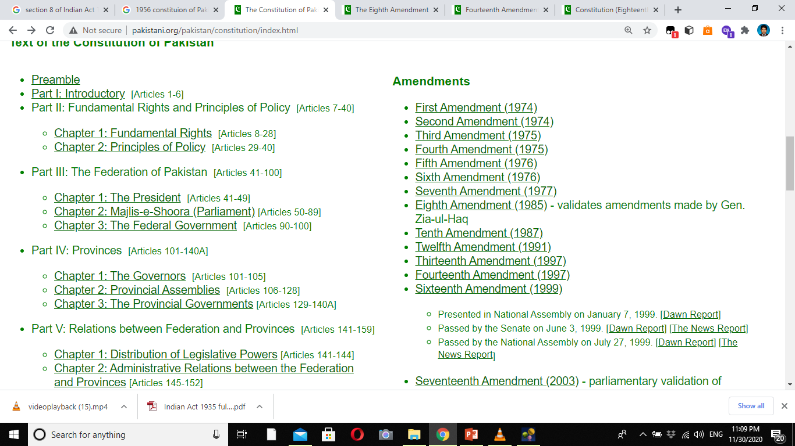
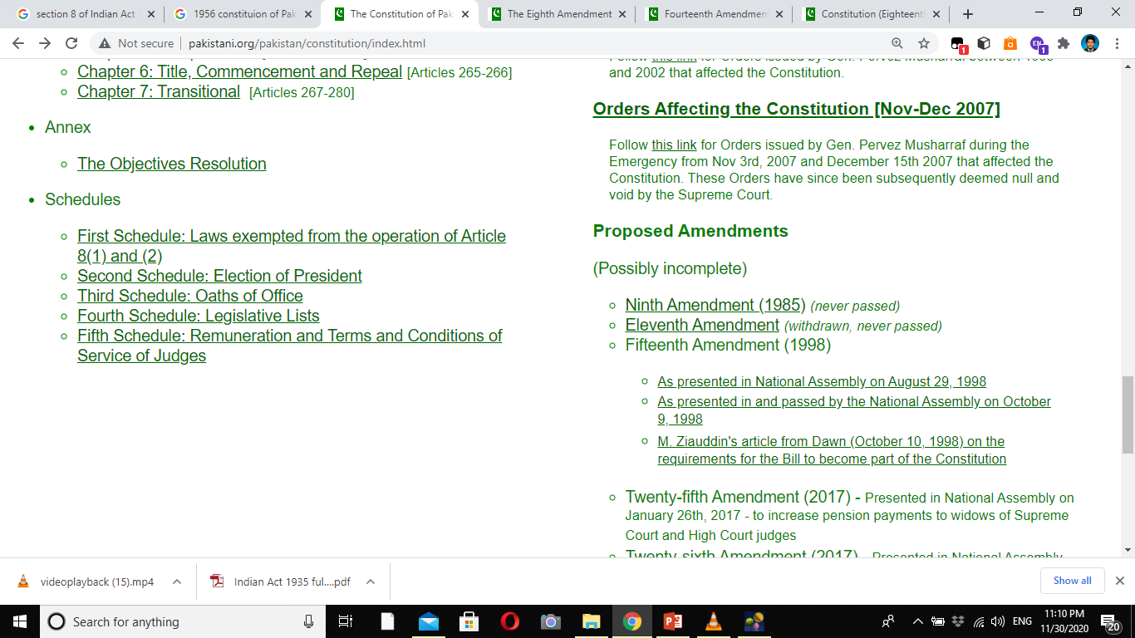

Slide 34
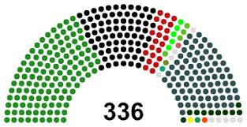

Category | No. of Seats
General Seats | 266
Women | 60
Non-Muslims | 10
Total | 336
Category | No. of Seats
General Seats | 48
Technocrats | 16
Women | 16
Non-Muslims | 4
Total | 96

